Slide 1


Latest Smartphone Trends: A Deep Dive
Join us for an exploration of the ever-evolving smartphone landscape. We'll examine key trends, market dynamics, and cutting-edge technologies shaping the future of this ubiquitous device.
by Abhishek Sharma

Slide 2
Smartphone Market Overview
Market Growth
Key Players
The global smartphone market has reached record levels, with over 1.4 billion units shipped in 2022. The market is expected to continue growing, driven by factors such as increasing smartphone penetration and the adoption of 5G technology.
The smartphone market is dominated by a few key players, including Samsung, Apple, Xiaomi, and Oppo. These companies compete fiercely for market share, offering a wide range of devices at different price points.

Slide 3
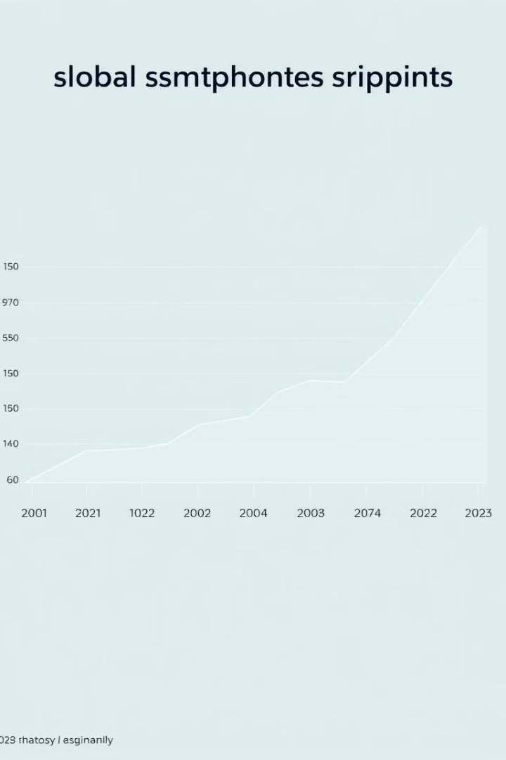
Global Smartphone Shipments (2021-2022)
1.4B
1.3B
2022
2021
Global smartphone shipments in 2022.
Global smartphone shipments in 2021.

Slide 4
Smartphone OS Market Share (2021-2022)
Android Dominance
iOS Steady
Android continues to dominate the smartphone operating system market, with a global market share of 85% in 2022.
iOS, Apple's mobile operating system, holds a steady market share of around 15%. This is due to the strong brand loyalty and premium pricing of Apple devices.

Slide 5
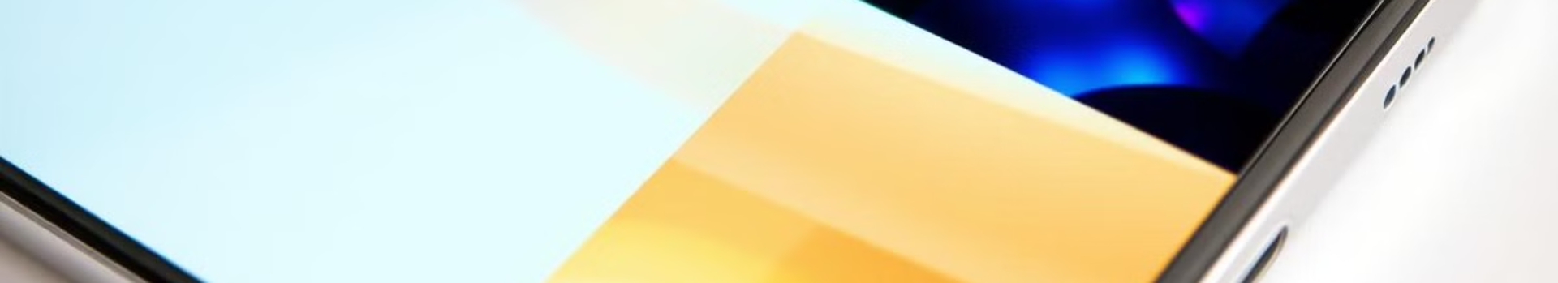
Smartphone Display Technology Advancements
1
OLED and AMOLED
2
Higher Resolution
3
Refresh Rates
OLED and AMOLED technologies are rapidly gaining popularity due to their superior image quality, deeper blacks, and wider color gamut. They also offer thinner and more power-efficient displays.
Smartphone displays are moving towards higher resolutions, with 2K and even 4K displays becoming increasingly common. This enables a more immersive viewing experience, especially for multimedia content.
Higher refresh rates, like 120Hz and 144Hz, are becoming popular features in high-end smartphones. They provide smoother scrolling and a more responsive user experience, especially for gaming and video playback.

Slide 6
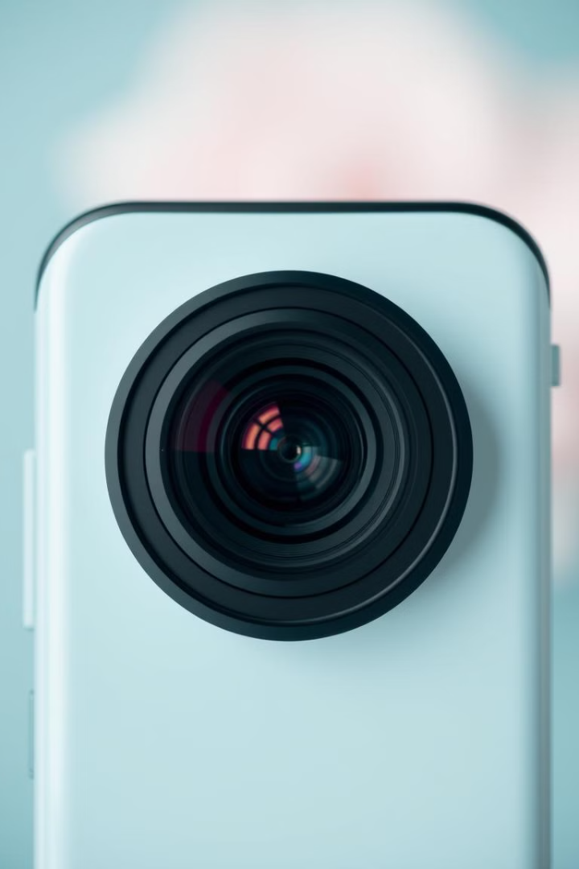



Smartphone Camera Capabilities and Megapixel Counts
Multi-lens Systems
Smartphone cameras are increasingly adopting multi-lens systems, often including wide-angle, telephoto, and macro lenses. This allows for greater versatility and creativity in capturing different scenes.
Megapixel Race
The megapixel race continues, with smartphones now boasting sensors with 50MP, 108MP, and even 200MP. However, megapixel count alone doesn't guarantee image quality; other factors, such as sensor size and image processing capabilities, are crucial.
AI-powered Image Processing
Artificial intelligence is playing a significant role in enhancing smartphone camera performance. AI algorithms can automatically adjust settings, optimize images in real-time, and even remove unwanted objects from photos.

Slide 7



Smartphone Battery Life and Charging Innovations
Larger Batteries
Smartphone batteries are becoming larger, with 5,000mAh and even 6,000mAh capacities becoming more common. This extends battery life and enables users to use their phones for longer periods without needing to recharge.
1
Fast Charging
2
Fast charging technologies, such as Quick Charge and Power Delivery, are now commonplace. These technologies allow for faster charging times, reducing the time users need to spend plugged in.
Wireless Charging
3
Wireless charging is becoming increasingly popular, offering a more convenient charging experience. Smartphones can be charged without cables, simply by placing them on a charging pad.

Slide 8

Conclusion: The Future of Smartphone Technology
The smartphone landscape is constantly evolving, with new innovations emerging regularly. From advanced displays and camera systems to innovative battery technologies, the future of smartphones is bright, promising even more impressive capabilities and user experiences.

